Slide 1
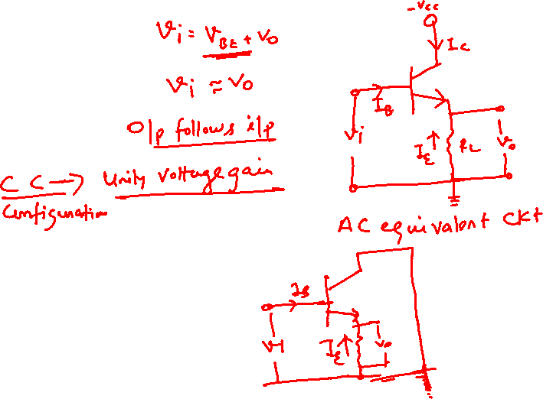
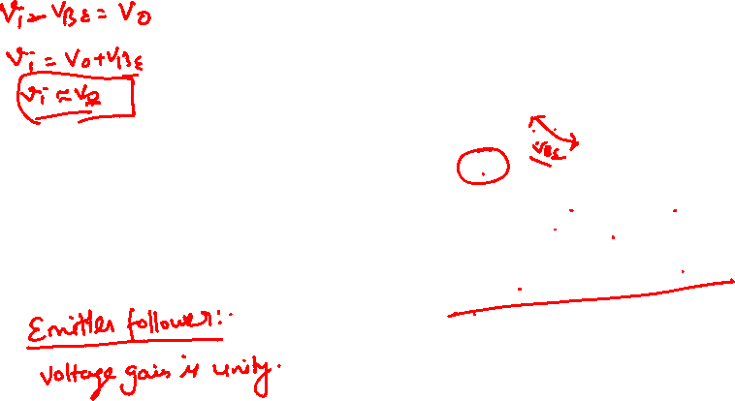
BJT

Slide 2
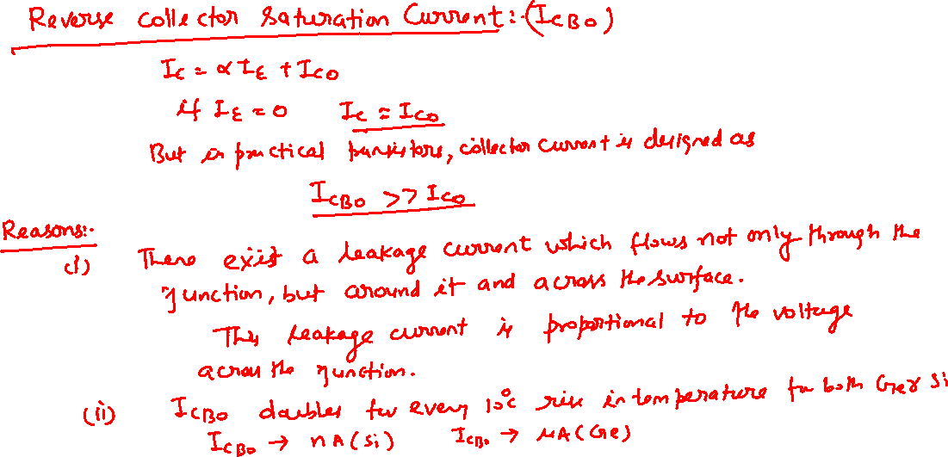

BJT

Slide 3
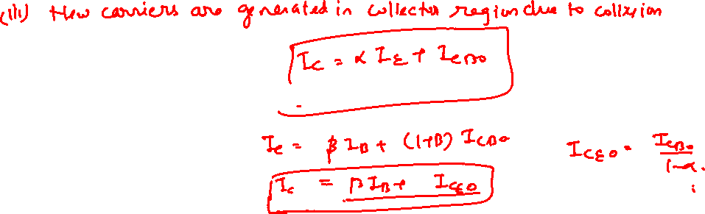
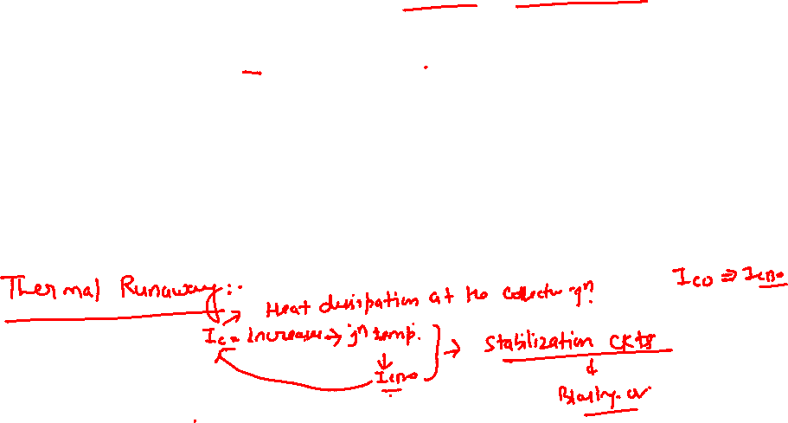
BJT

Slide 4
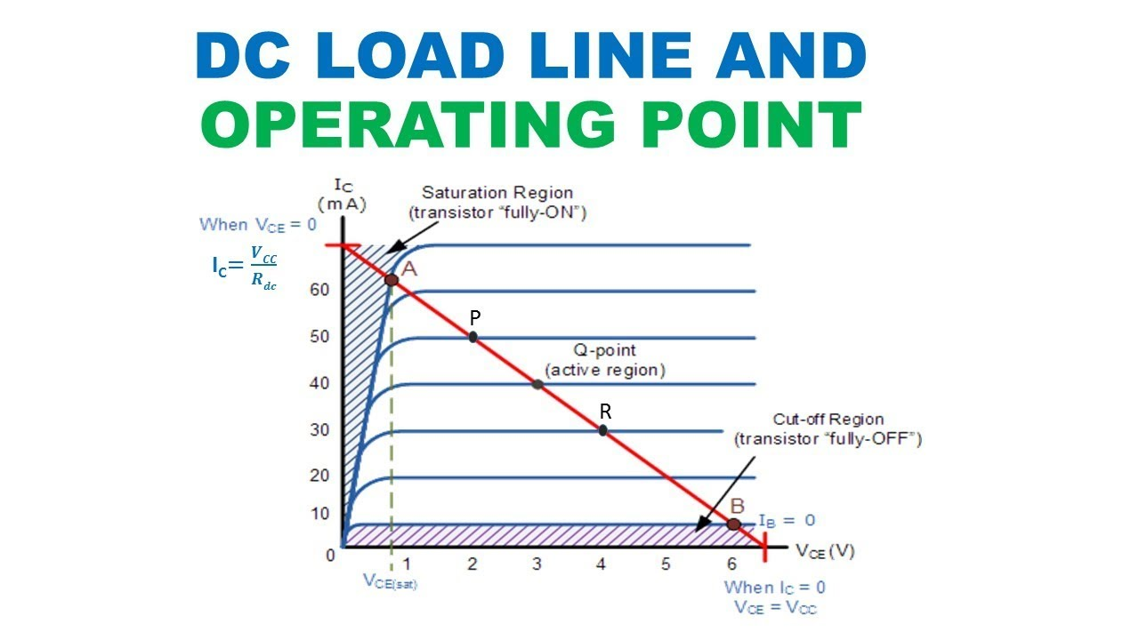
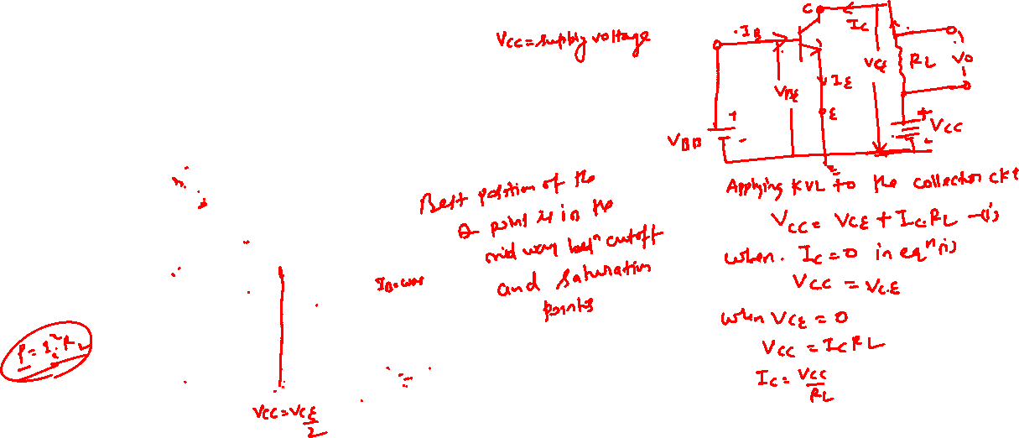
Transistor Load Line

Slide 5

DC Load Line
The straight line is known as the DC load line. The dc load line is a graph that represents all the possible combinations of I_{C} and V_{CE} for a given amplifier. For every possible value of I_{C}, and amplifier will have a corresponding value of V_{CE}.)
When a transistor does not have an ac input, it will have specific dc values of IC and VCE.
These values correspond to a specific point on the dc load line. This point is called the Q-point.
The intersection of the dc bias value of I_{B} with the dc load line determines the Q-point.
It is desirable to have the Q-point centered on the load line.
Midpoint biasing allows optimum ac operation of the amplifier.

Slide 6
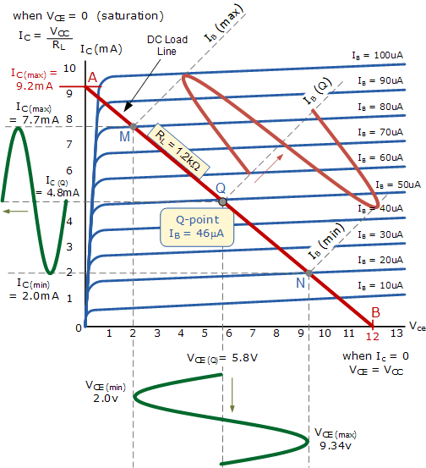
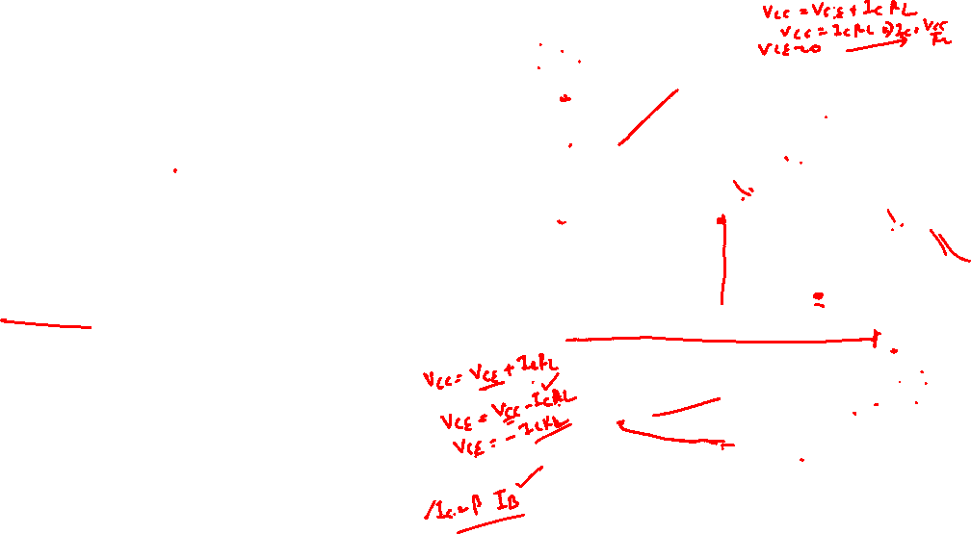
Transistor Load Line (AC)
When an ac signal is applied to the base of the transistor, I_{C} and V_{CE} will both vary around their Q-point values.
When the Q-point is centered, I_{C} and V_{CE} can both make the maximum possible transitions above and below their initial dc values.
When the Q-point is above the center on the load line, the input signal may cause the transistor to saturate. When this happens, a part of the output signal will be clipped off.
When the Q-point is below midpoint on the load line, the input signal may cause the transistor to cutoff. This can also cause a portion of the output signal to be clipped.
The ac load line is used to tell you the maximum possible output voltage swing for a given common-emitter amplifier.

Slide 7
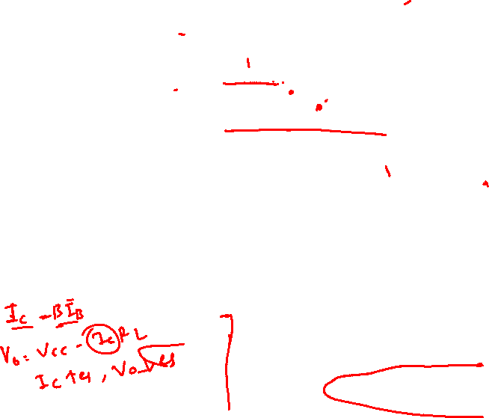

Slide 8
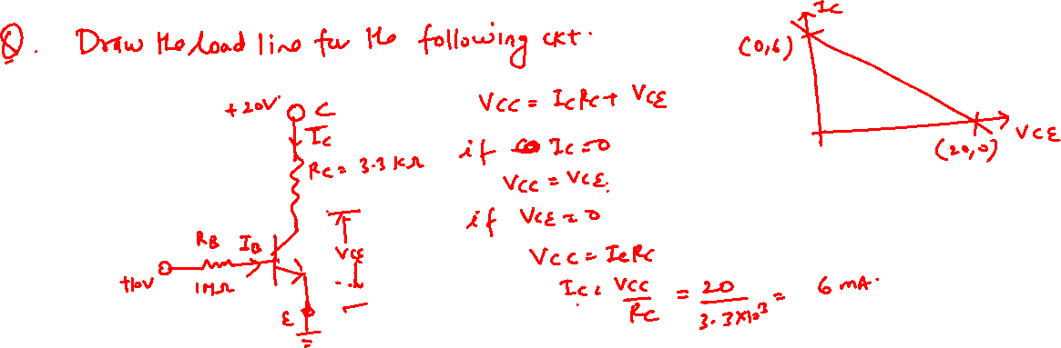
BJT

Slide 9
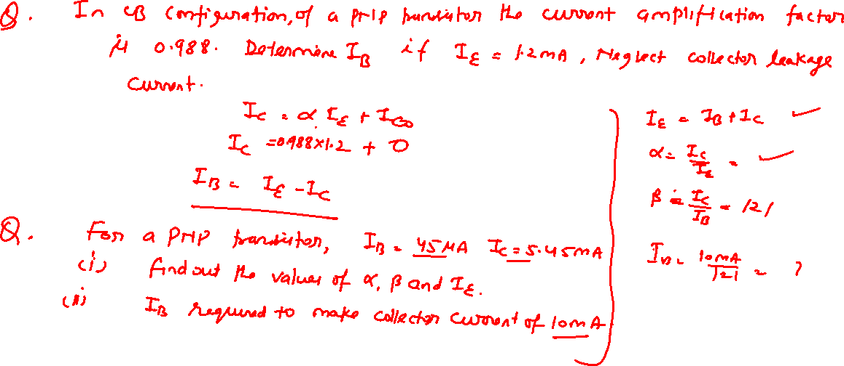
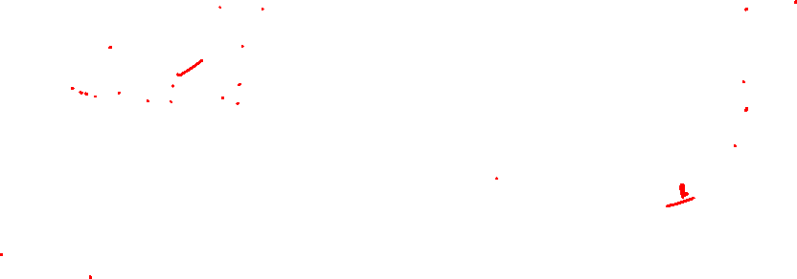
BJT

Slide 10
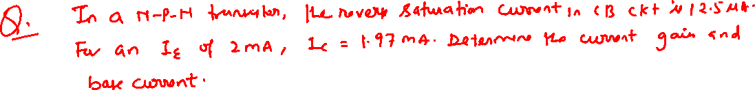
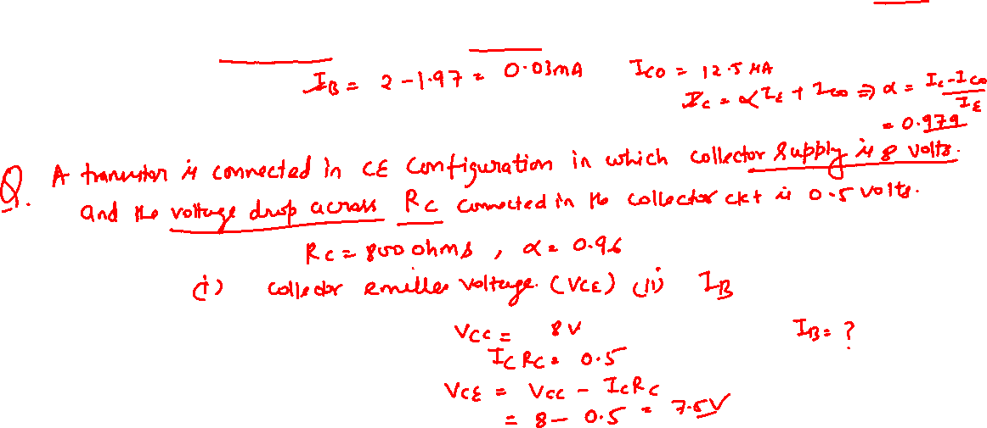
BJT

Slide 11
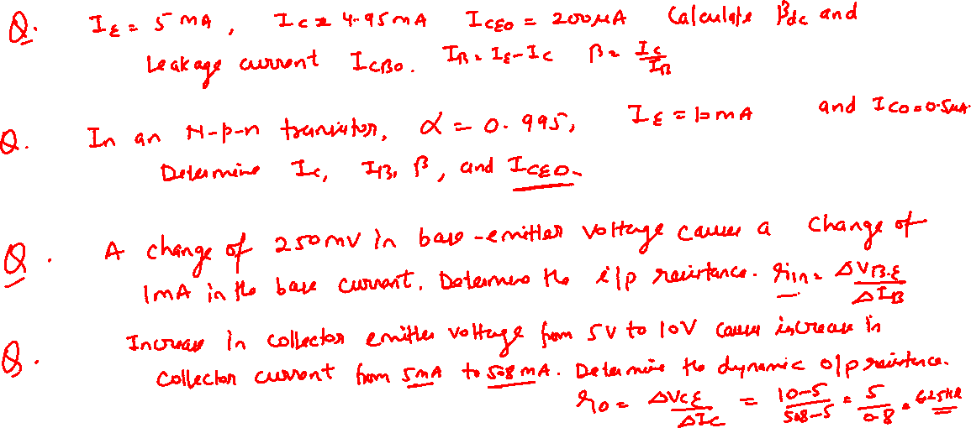
BJT

